Slide 1
FRUPAL & Linked Lists
Lecture 7A

Slide 2
FRUPAL
/u/cgi_web/FRUPAL/step2

Slide 3
Revisit the Assignment
use structs
Re-implement your FRUPAL map as an array of structs – so each map cell is a struct containing a “visibility flag“ (0=not visible, 1=visible), a terrain identifier (0=meadow, 1=forest, 2=water,3=wall) and a content string (Tree, Boulder, Blackberry Bushes, Power Bar, Treasure Chest, Royal Diamonds, Hatchet, Axe, Chainsaw, Chisel, Sledge, Jackhammer, Machete, Binoculars, None). None indicates the Map Cell is empty.

Slide 4
FRUPAL main()
void main(void)
{
char move; /* player move character */
int heroRow, heroCol; /* current hero coordinates */
int lastRow, lastCol; /* prior hero coordinates */
int energy, bank; /* player resources */
mapCell map[ROW][COL]; /* game map */
initializeMap(map,&heroRow,&heroCol,&energy,&bank);
printf("FRUPAL V0.1\n%d Rows by %d Columns\n",ROW,COL);
while(FOREVER)
{
getMove(&move);
makeMove(move,map,&heroRow,&heroCol,&lastRow,&lastCol,
&energy,&bank);
}
}

Slide 5
The FRUPAL Map Data Structure
typedef struct {
int visibility;
int terrain;
char contents[20];
} mapCell;

Slide 6
Initializing the Map Data Structure
for(i=0;i<ROW;i++) /* initial values for map */
{
for(j=0;j<COL;j++)
{
map[i][j].visibility=0;
map[i][j].terrain=0;
strcpy(map[i][j].contents,"None");
}
}

Slide 7
Moving North in makeMove
void makeMove(char move,
mapCell map[ROW][COL],
int *heroRow, int *heroCol, int *lastRow, int *lastCol,
int *energy, int *bank)
{
switch (move)
{
case 'N':
printf("Moving North\n");
*heroRow = *heroRow - 1;
if(*heroRow < 0)
{
*heroRow = ROW - 1;
}
*energy = *energy - 1;
map[*heroRow][*heroCol].visibility=1;
break;

Slide 8
Add a map display feature
Also add a map print function to the status command. Invisible map cells will be represented by an “XXX”, visible map cells that are empty will be represented by “000”, “111”, “222” or “333” corresponding to their terrain identifier. If the cell has content, instead display their terrain identified as “+0+”, “+1+”, “+2+” or “+3+”
Finally, add a “secret” command “Z” that will display the map as above, but *all* cells will be visible

Slide 9
Displaying the Map
a nested loop on i and j
{
if((map[i][j].visibility==1)||(cmnd=='Z')){
if(strcmp(map[i][j].contents,"None")==0)
{
printf("%d%d%d",map[i][j].terrain x 2 more);
}
else
{
printf("+%d+",map[i][j].terrain);
}
}
else
{
printf("XXX");
}

Slide 10
UNIONS

Slide 11
Unions
Allow a given variable to take on several possible values
Polymorphic
Like a struct, but members share the same memory location

Slide 12
Using a union to generate a string
#include <stdio.h>
void main(void)
{
typedef union {
char aString[8];
int aNumber;
} grabBag;
grabBag a;
a.aNumber = 1094861636;
printf("%d\n",a.aNumber);
printf("%s\n",a.aString);
}

Slide 13
How did we do this?
one integer = 4 bytes/one character = 1 bytes
Figure out the hex codes for each letter:
‘A’ = 41, ‘B’ = 42, ‘C’ = 43, ‘D’ = 44
What is the decimal value of 0X 41424344?
www.binaryhexconverter.com/hex-to-decimal-converter
1094861636
You’ll need to invert the letters since our architecture is little endian – least significant digit first

Slide 14
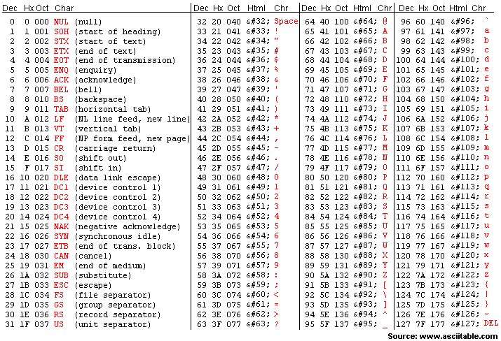
Standard ASCII Codes (0-127)

Slide 15
POINTERS AND LINKED LISTS

Slide 16
bookinfo definition
bookinfo.h:
  typedef struct {
  char title[20];
  char author[20];
  int year;
  int wordCnt;
  } bookinfo;

Slide 17
Using a Pointer to an Array of structs
void main(void)
{
bookinfo newBook[10];
bookinfo *p;
strcpy(newBook[5].title,"Walden");
strcpy(newBook[5].author,"Thoreau");
newBook[5].year = 1854;
newBook[5].wordCnt = 114634;
newBook[6] = newBook[5];
p = &newBook[5];
printf("%s\n",(*p).title);
printf("%s\n",(*(p+1)).title);
}

Slide 18
Why (*p)?
Member specification takes precedence over dereferencing
*p.title implies *(p.title) NOT (*p).title
When using pointers with structs, use ‘->’

Slide 19
Using a Pointer to an Array of structs
void main(void)
{
bookinfo newBook[10];
bookinfo *p;
strcpy(newBook[5].title,"Walden");
strcpy(newBook[5].author,"Thoreau");
newBook[5].year = 1854;
newBook[5].wordCnt = 114634;
newBook[6] = newBook[5];
p = &newBook[5];
printf("%s\n", p->title);
printf("%s\n",(p+1)->title);
}

Slide 20
Using structs to point to other instances of the same variable
void main(void)
{
typedef struct list {
int payload;
struct list *next;
} list;
list a, b, c, *d;
int i;
a.payload = 10; a.next = &b;
b.payload = 20; b.next = &c;
c.payload = 30; c.next = &a;
d = &a;
for(i=0;i<5;i++)
{
printf("%d\n",*d.payload);
d = *d.next;
}
}

Slide 21
Using structs to point to other instances of the same variable
void main(void)
{
typedef struct list {
int payload;
struct list *next;
} list;
list a, b, c, *d;
int i;
a.payload = 10; a.next = &b;
b.payload = 20; b.next = &c;
c.payload = 30; c.next = &a;
d = &a;
for(i=0;i<5;i++)
{
printf("%d\n",(*d).payload);
d = (*d).next;
}
}

Slide 22
Using structs to point to other instances of the same variable
void main(void)
{
typedef struct list {
int payload;
struct list *next;
} list;
list a, b, c, *d;
int i;
a.payload = 10; a.next = &b;
b.payload = 20; b.next = &c;
c.payload = 30; c.next = &a;
d = &a;
for(i=0;i<5;i++)
{
printf("%d\n",d->payload);
d = d->next;
}
}

Slide 23
Linked List
d
a
10
b
20
c
30

Slide 24
Using -> with a struct pointer and a function
void printBook(bookinfo *book)
{
printf("FROM FUNCTION: %s\n",book-> author);
return;
}
void main(void)
{
bookinfo newBook[10];
bookinfo *p;
…
p = &newBook[5];
printBook(p);
}

Slide 25
Allocating space w/o a variable declaration: calloc
calloc:
  ptr = calloc(# of cells, size of cells)
allocates a block of contiguous memory starting at ptr initialized to zeros
Can use sizeof() function (stdlib.h) to return size of the cells:
  ptr = calloc(sSize,sizeof(int));

Slide 26
Allocating space w/o a variable declaration: malloc
malloc:
  ptr = malloc(# of bytes to allocate)
allocates a block of contiguous memory starting at ptr leaving original values in the memory locations
  ptr = malloc(sSize*sizeof(int));

Slide 27
Releasing Memory
When you are done using dynamic memory, you should release it using:
free(ptr);

Slide 28
The list struct typedef
typedef struct list {
int payload;
struct list *next;
} list;

Slide 29
Using a struct with dynamic memory …
void main(void)
{
list *head, *current;
int i;
current = malloc(sizeof(list));
current->payload = 10; current->next = NULL;
head = current;
printf("%d\n",head->payload);
}

Slide 30
Turning it into a linked list …
void main(void)
{
list *head, *current;
int i;
current = malloc(sizeof(list));
current->payload = 10; current->next = NULL;
head = current;
current = malloc(sizeof(list));
head->next = current;
current->payload = 20; current->next = head;
for(i=0;i<6;i++)
{
printf("%d\n",head->payload);
head = head->next;
}
}

Slide 31
Common Linked List Operations
Traverse the list
Add an element to the end of the list
Add an element to the middle of the list
Add an element to the front of the list
Remove an element from the end of the list
Remove an element from the middle of the list
Remove an element from the front of the list

Slide 32
Building and Traversing
a linked list
void main(void) {
list *head, *current, *last; int i;
current = malloc(sizeof(list));
head = current;
for(i=0;i<10;i++) {
current->payload = rand();
last = current;
current = malloc(sizeof(list));
last->next = current;
}
current->payload = rand();
current->next = head;
current = head;
for(i=0;i<20;i++) {
printf("%d\n",current->payload);
current = current->next;
}
}

Slide 33
Types of Lists
Circular linked list
Linear linked list – special value NULL
Multilist
Doubly linked list (a type of multilist)
Trees (also a type of multilist)

Slide 34
The listf struct typedef
typedef struct list {
float payload;
struct list *next;
} list;

Slide 35
Loading and Displaying GPAs
void main(void)
{
list *head, *last, *current;
FILE *gpas;
gpas=fopen("/u/warren/NB/gpas","r");
head = malloc(sizeof(list));
head->next = NULL;
current = head;
while(fscanf(gpas,"%f",&current->payload)!=EOF)
{
last = current;
current = malloc(sizeof(list));
current->next = last->next;
last->next = current;
}
dumpList(head);
fclose(gpas);
}

Slide 36
Displaying the GPA List
void dumpList(list *head)
{
list *current;
current = head;
do
{
printf("%.1f\n",current->payload);
current = current->next;
} while(current->next != NULL);
}

Slide 37
Program 7A
We’ll take a break from FRUPAL until we learn about linked lists. So here is the next assignment.
Create a linked list from a file containing state names and the number of electoral votes that state has from: /u/warren/NB/electoral. Your list should have as members, the name of the state, the number of electoral votes and a pointer to both the next item in the list and a pointer to the pervious item in the list.
Then display all the states that have an above average number of electoral votes. Do this twice: once, processing from beginning to end and once processing from end to beginning. Do you get the same answer?

Slide 38
Program 7A List
Alabama
9
tail
Nevada
6
head
Florida
29

